Slide 1
TOR NETWORKS:
Anonymity, Security, Protocol and Weaknesses
Computer architecture | University of Hradec Králové
Iván López Justicia

Slide 2
Index
Origin
Design
Working behaviour
Applications and use
TOR vs Others anonymous methods
Security
Debilities

Slide 3

Origin | What is?
TOR means The Onion Router.
It is a network which allows us to access to Internet in a anonymous way.
Certainly, TOR hide the origin and destination of the Internet’s traffic, what make complicated for external people to know who you are and what you are doing online.

Slide 4



Origin | First versions and developers
The first version of TOR was published as alfa in 2002. One year after, it arose as the evolution of the Onion Routing Project of US Naval Research Lab (NRL).
It was created for Roger Dingledine, Nick Mahtewson and
Paul Syverson

Slide 5
Origin | EVOLUTION
United States Naval Research Lab
It was the first institution which financed the project and which created it

Slide 6
Origin | EVOLUTION
United States Naval Research Lab
It was the first institution which financed the project and which created it
Electronic Frontier Foundation
At the end of 2004, the project was financed for Electronic Frontier Foundation, a foundation of defense of civil freedoms in the digital world

Slide 7
Origin | EVOLUTION
United States Naval Research Lab
It was the first institution which financed the project and which created it
Electronic Frontier Foundation
At the end of 2004, the project was financed for Electronic Frontier Foundation, a foundation of defense of civil freedoms in the digital world
The Tor Project
Actually the project is in The Tor Project hands, a non-profit organization leaded for the cofounder Roger Dingledine

Slide 8
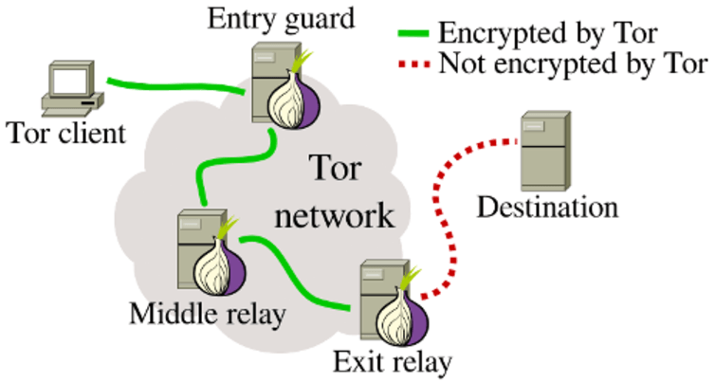
Design| TOR CIRCUIT

Slide 9
Design| COMPONENTS
ENTRY GUARD: It is the entry point to the TOR Network. Each client that wants to connect to the TOR network will first connect to the guard node

Slide 10
Design| COMPONENTS
MIDDLE RELAY: Middle relays cover most part of the Tor circuit in any given transmission.

Slide 11
Design| COMPONENTS
EXIT RELAY: The exit relay is the final relay in the TOR circuit.

Slide 12
WORKING BEHAVIOUR |
We are going to suppose a case of connection between two friends, Alice and Bob:
Alice → TOR → Bob
Alice → Entry guard → Services

Slide 13
WORKING BEHAVIOUR |
We are going to suppose a case of connection between two friends, Alice and Bob:
Alice → TOR → Bob
Alice → Entry guard → Services
Entry guard → Random selection → Middle Relay
Middle Relay → … → Exit Node

Slide 14
WORKING BEHAVIOUR |
We are going to suppose a case of connection between two friends, Alice and Bob:
Alice → TOR → Bob
Alice → Entry guard → Services
Entry guard → Random selection → Middle Relay
Middle Relay → … → Exit Node
Exit Node → Bob

Slide 15
Applications and Use |
The main purpose is to keep the anonymity in Internet, that’s why it used for:
Normal people:
Journalists and their audience:
Law enforcement officers:
Activists and whistle-blowers:
Others.

Slide 16
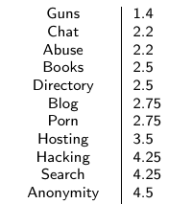
Applications and Use |
Despite its main idea of use it for safe people from bad intentions of bad people, its features imply that websites of dubious reputation can be hosted there.

Slide 17
TOR vs OTHER OPTIONS| VPN vs tor
VPN will encrypt all traffic between your device (computer, tablet, router, smartphone etc.) and a VPN server. This makes traffic (your online activities) unreadable to third parties, such as your internet provider, hackers, and any other snoopers.
In general, a good VPN service offers some advantages:
Much better performance than Tor
System-wide encryption.
More versatility.
Supported on many devices and operating systems.
More trust.
Many users.

Slide 18
TOR vs OTHER OPTIONS| Multi-hop vpn
Similar to the Tor network, there are also a few VPN services that will route traffic across multiple VPN servers, .
Double-hop VPNs: Your traffic is being encrypted over two separated servers before exiting to the destination.
Self-configurable multi-hop VPNs: With self-configurable VPN services, you can build your own unique cascade by choosing the servers you want.

Slide 19
Security| Onion routing
Every connection between each of the middle relays is encrypted with a new key (onion’s layers)
The communication is unidirectional, one middle relay knows the previous and the next one, but no more.
Every some minutes the path change.

Slide 20
Debilities|
Exists several ways to know if a determinate traffic is sent through TOR:
Check some ports: 443, 9001…
Check the veracity of the certificates.
Climb through the IPs using the node list.
Sniffing the Exit Node

Slide 21
THAKS FOR YOUR ATTENTION
Iván López Justicia University of Hradec Králové Computer Architecture

